Slide 1

Hangman
Aadil Sohail

Slide 2
Main Objectives
Allow the user to chose the difficulty of the word that is generated
Read from a file and generate a random word
Allow the user to play a simple hangman game once the word is generated
Write some basic information about the game to a file once a game has been won or lost.

Slide 3
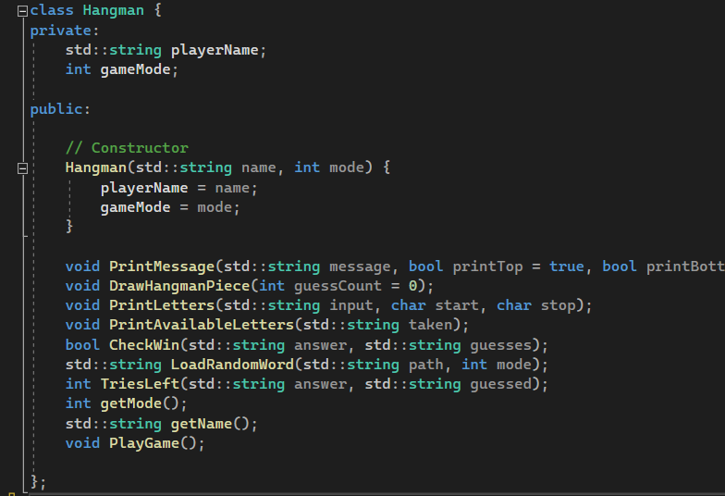
Hangman class

Slide 4
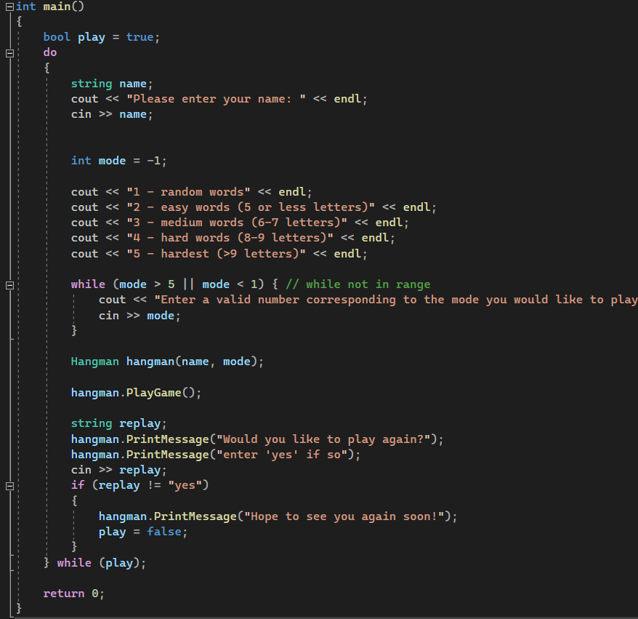
main()
While play variable is true the loop repeats
We get the users name and preferred mode and initialize a hangman object
We call PlayGame()
Once the game ends, we ask the user if they would like to play again

